Slide 1
Introduction to image processing and analysis with ImageJ / Fiji. Part 2 ImageJ / Fiji – The basics
Dale Moulding
UCL Institute of Child Health Imaging Facility

Slide 2
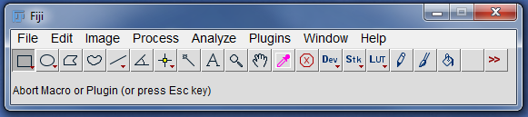
ImageJ/Fiji interface
Menu Bar
Tool Bar
Status Bar
Macro
toolset
switcher
Progress Bar
Double left click: opens the option window
Right click: selects a different tool
Remember ! All operations are performed on the active window i.e. the frontmost image with the highlighted title bar.

Slide 3
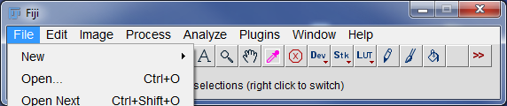
How to open your files…
File>Open
Drag and Drop (files/folders)
File>Import>Image Sequence … (if you have a folder full of files that make a movie or 3D stack)

Slide 4
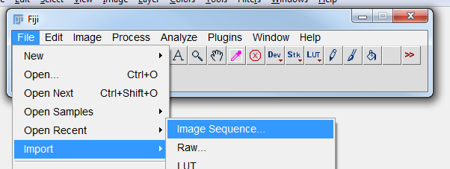
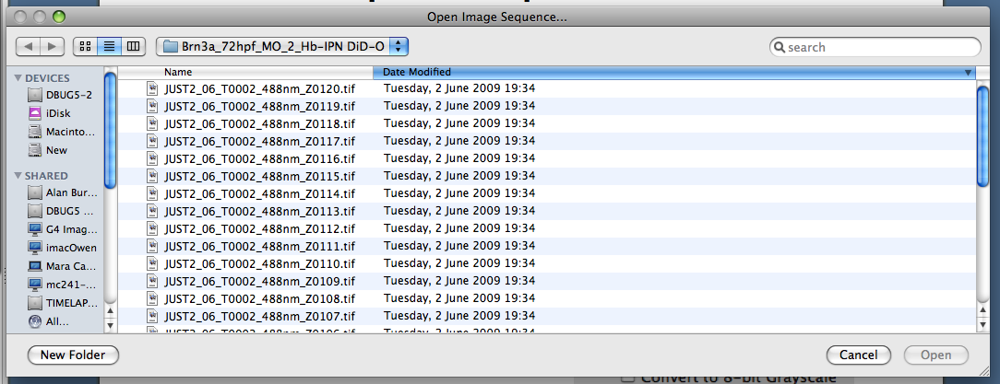
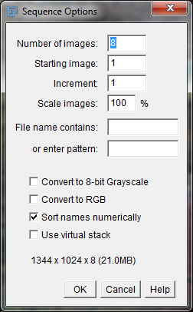
File>Import>Image Sequence
Opens a series of images in a folder as a stack. The images must all be the same size and type.
1- Select folder and one file
2- Specify options
Example: zebrafish

Slide 5
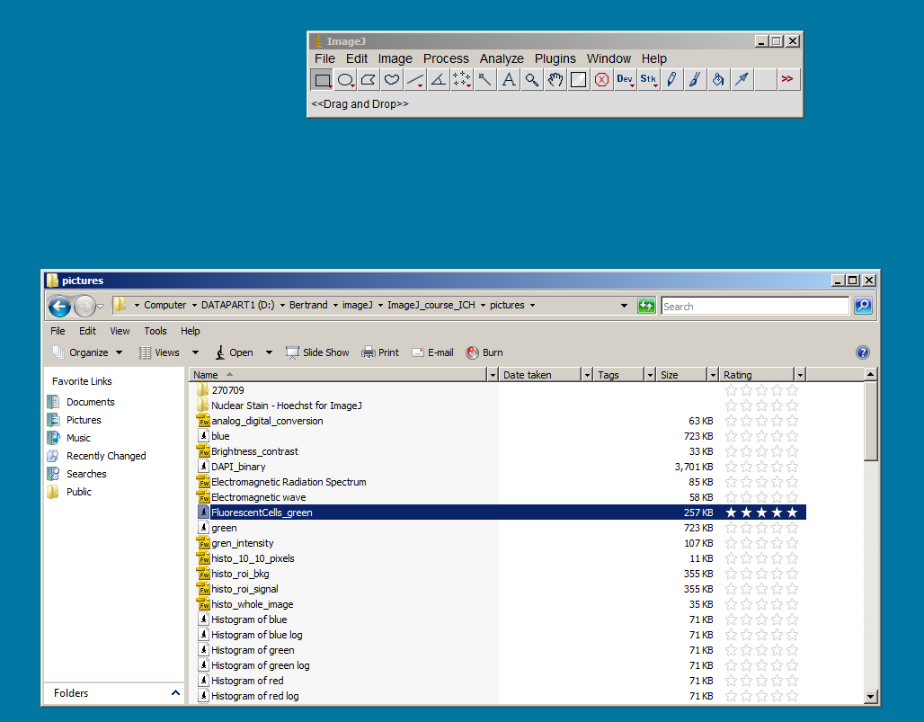
Drag and drop
Works with single files,
multiple files or folder
Try it with the Zebrafish folder

Slide 6
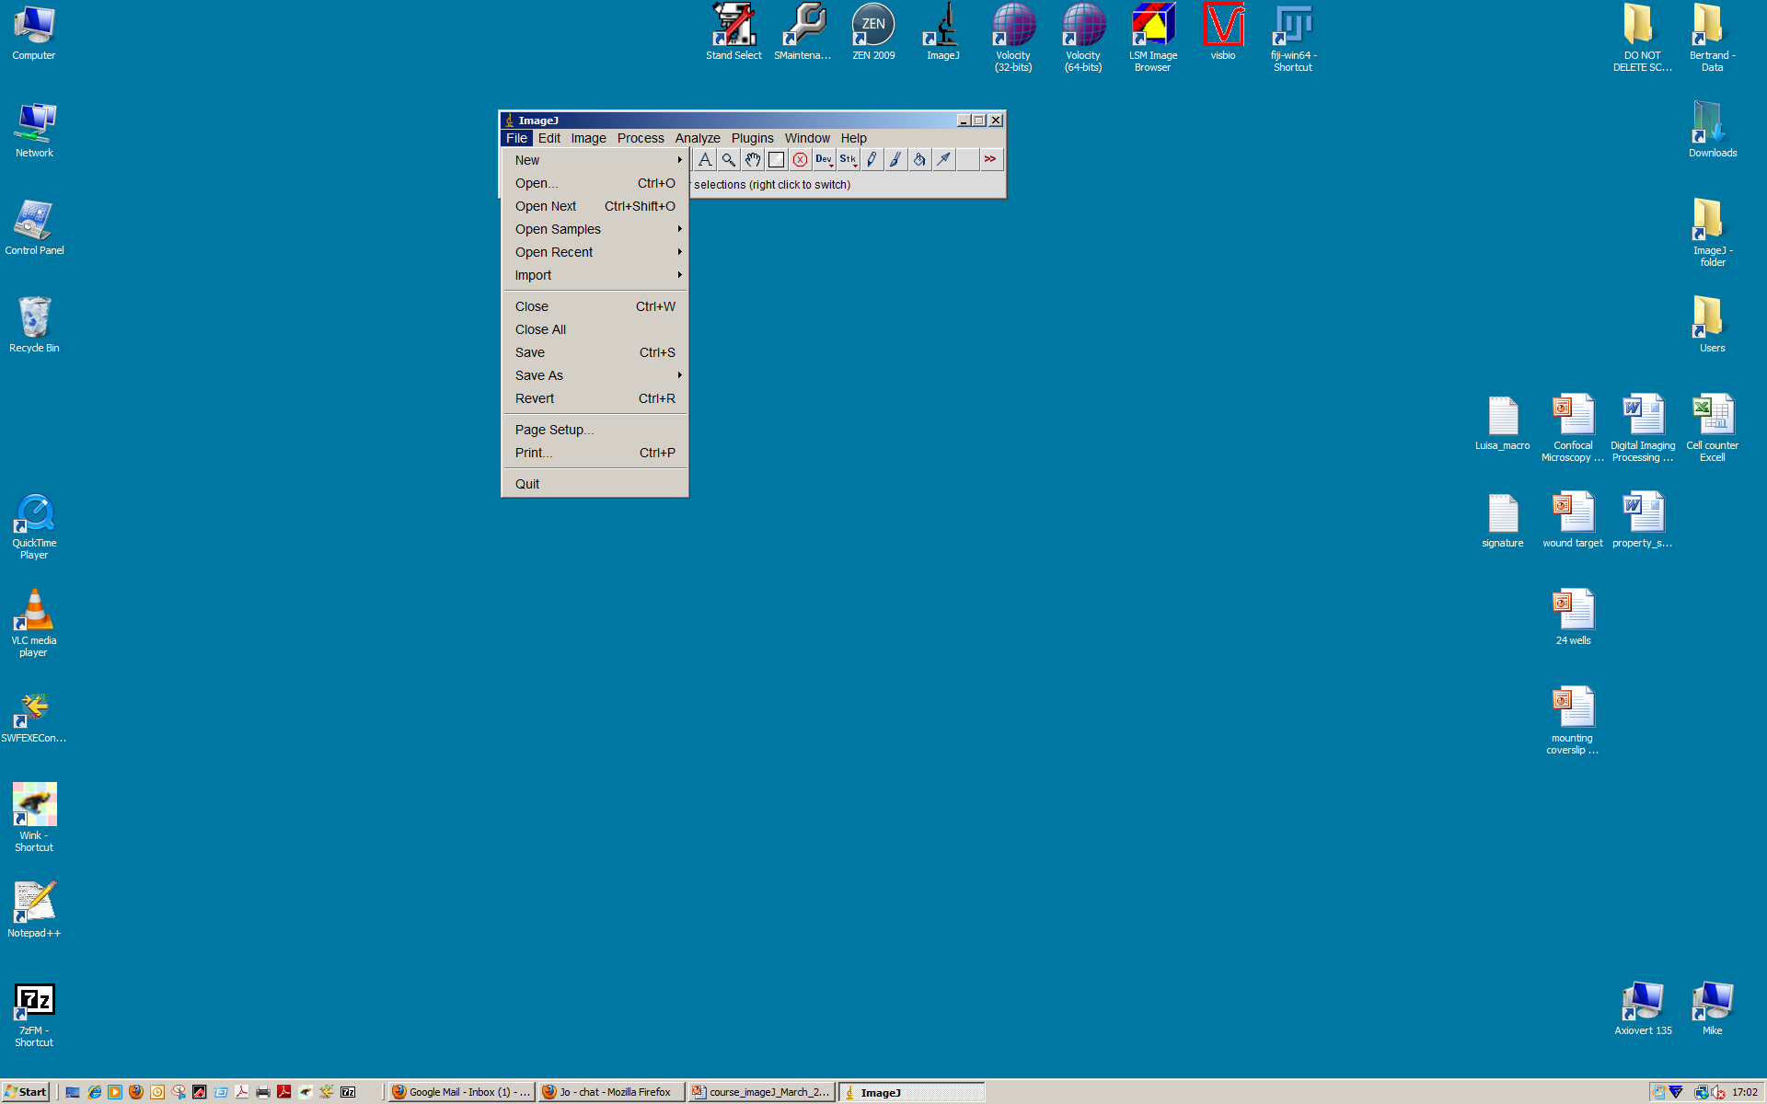
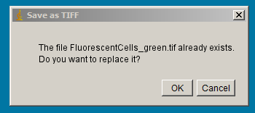
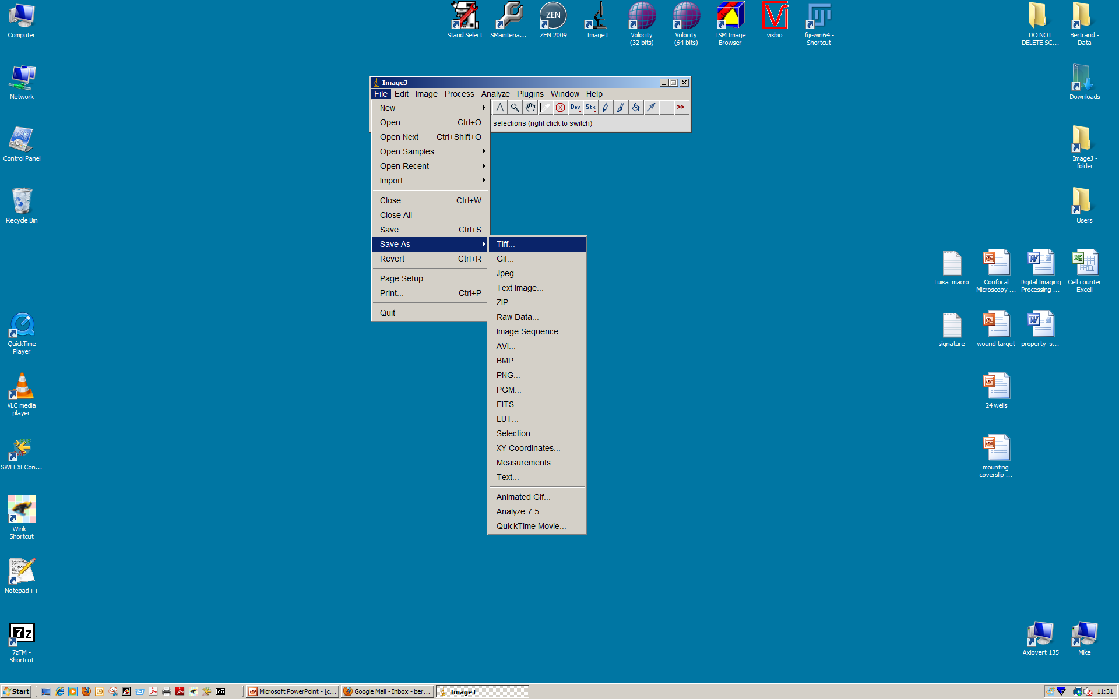
Saving data
File>Save (as Tiff the active window)
Caution : If the original file is already a Tiff file, it will be replaced by the new file !
File>Save as…
Tiff (8-bit, 16-bit, 32-bit float and 24-bit RGB)
ZIP : as tiff in a compressed ZIP archive
Image sequence : every slice of a stack (Z or time) save as individual tiff file.
Others formats
DO NOT USE JPEG LOSSY COMPRESSION

Slide 7
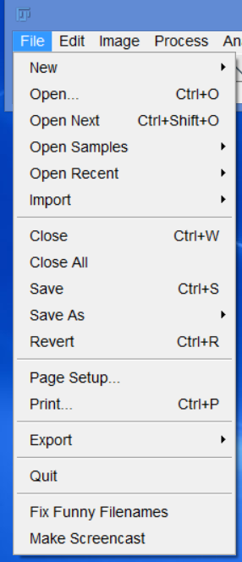
File Menu
All self explanatory
but wait a minute…
Revert (re-opens last saved version)
Fix Funny Filenames!?!
Make Screencast:
records a movie of the screen as an .ogv file
You can change it to an .mp4 file in ‘Handbrake’,
where you can also crop and clip the movie.

Slide 8
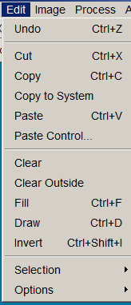
Edit Menu
Not always available
Copy to the internal clipboard
the content of the internal clipboard (Can check by File > New > System Cilpboard – Ctrl + Shift + V)
clear the selection and replace by background colour
clear outside the selection and replace by background colour
fill the selection with foreground color
outlines the selection (I prefer ROI manager for drawing)
creates a “negative image”

Slide 9
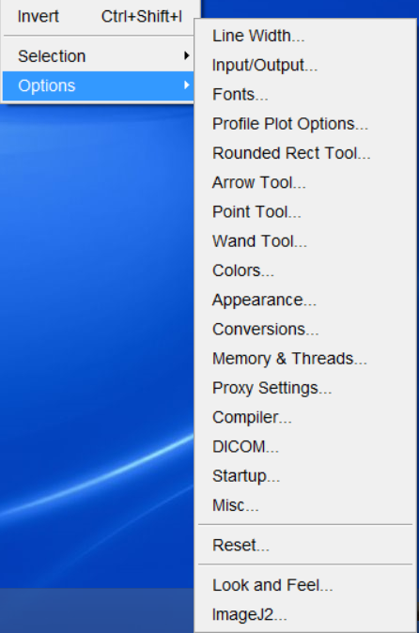
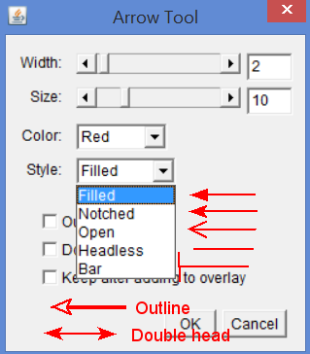
Edit / Options >
Saving options (jpeg quality, results output)
Change corner sizes
Very useful…
Details later
Change foreground & background colours
Startup macros
Use CTRL key
for shortcuts

Slide 10
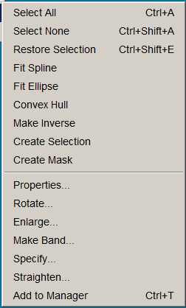
Edit>Selection Menu
Transfer selection between images
Change a mask (binary image) to a selection (ROI)
Region Of Interest manager – My Favourite!

Slide 11
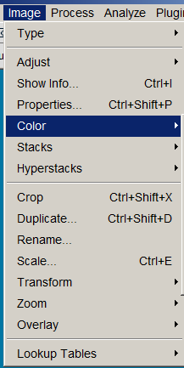
Image Menu
Switch between bit depths and colour type
Many functions in here…
Image meta-data
Dealing with multichannel images
3D images &
time series
Remember this shortcut
Rotate, flip etc
Apply colour to an image

Slide 12
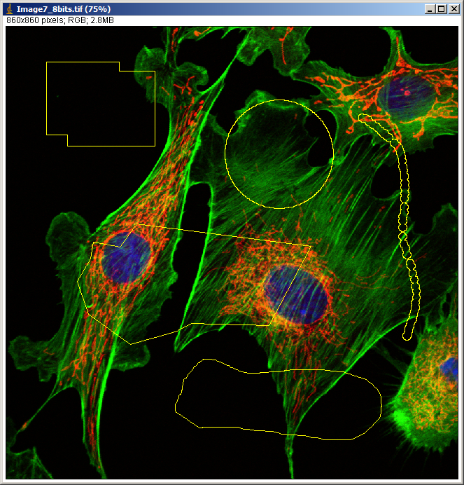
Selections
Selection tools http://rsbweb.nih.gov/ij/docs/guide/146-10.html#toc-Section-10
Edit menu http://rsbweb.nih.gov/ij/docs/guide/146-27.html#toc-Section-27

Slide 13
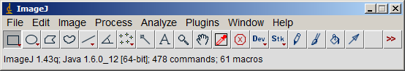
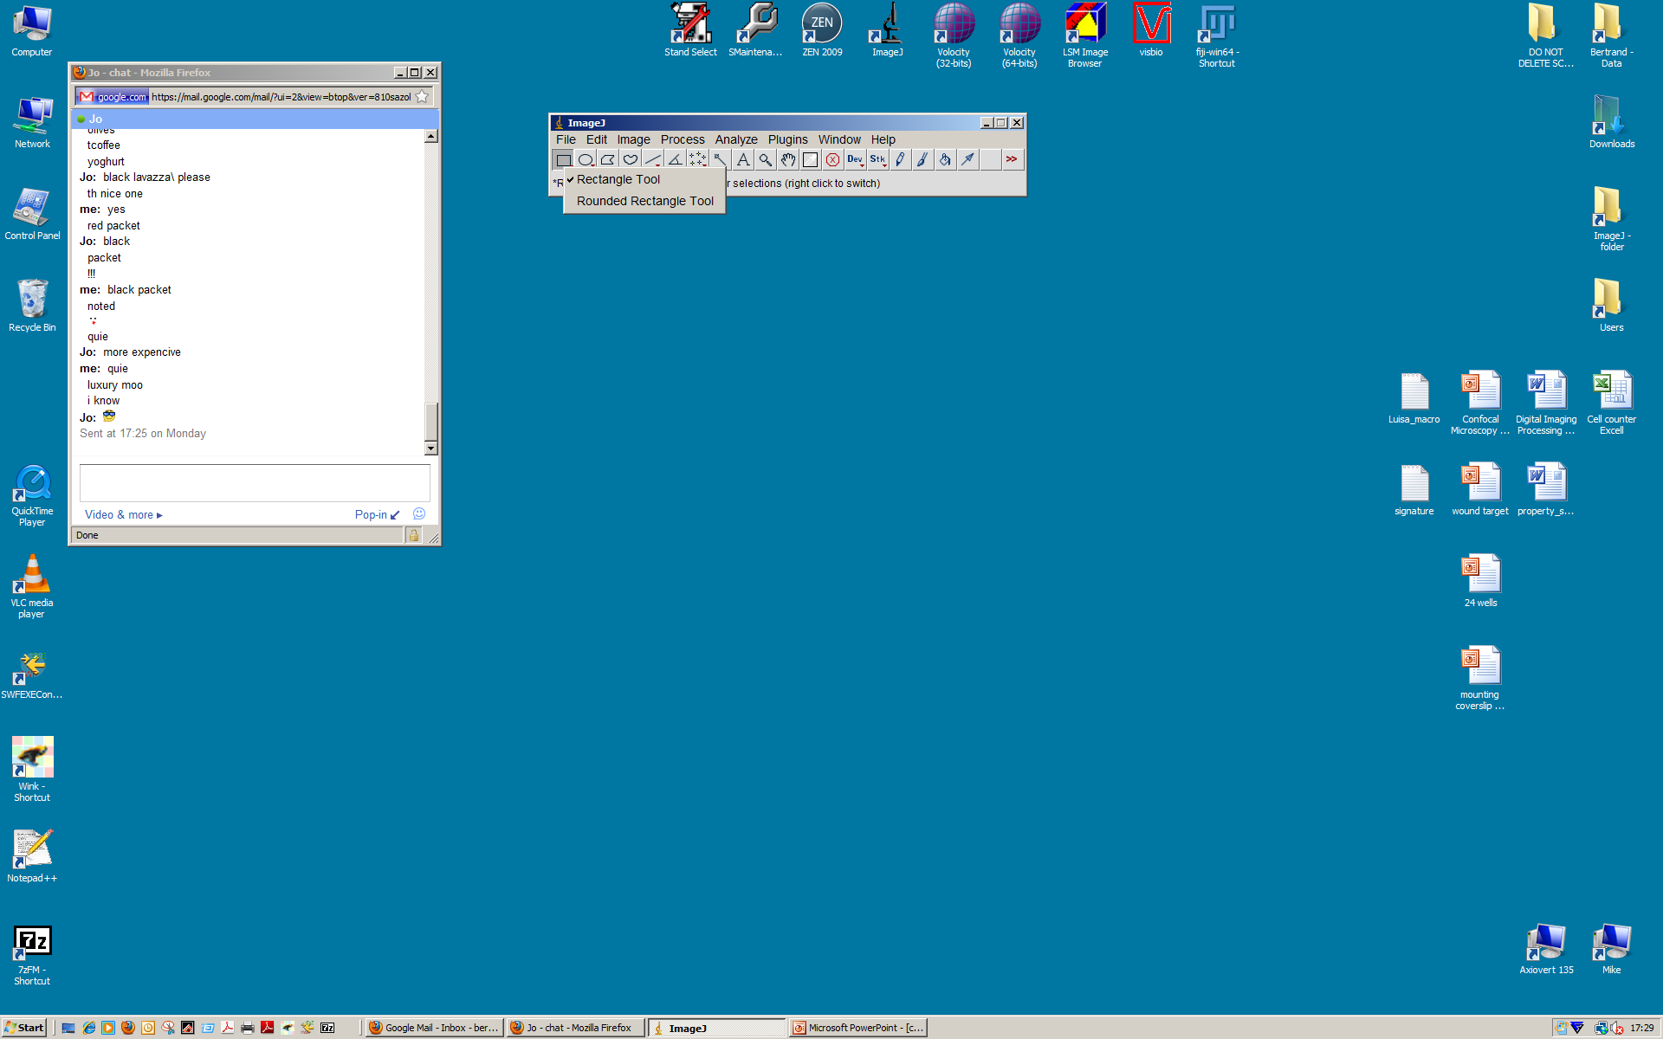
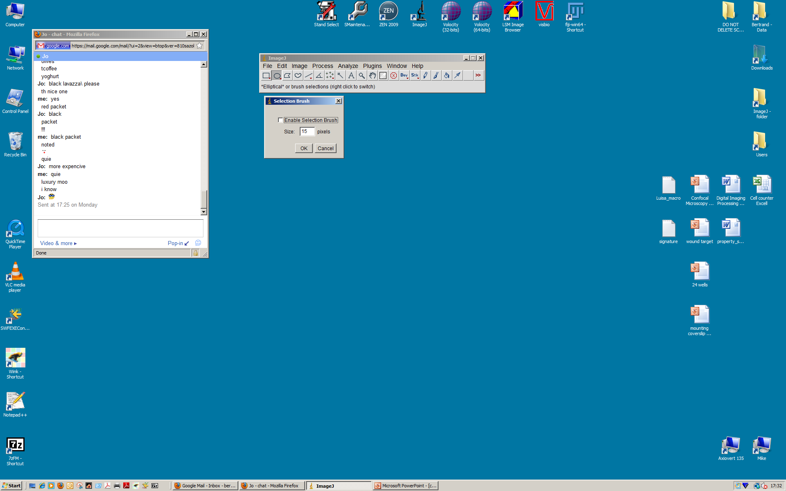
Selection tools
Left click
Right click
for more tools
Double left click
for tool options

Slide 14
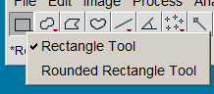
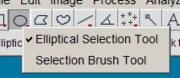
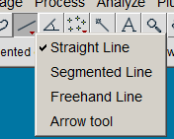
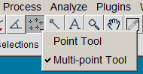
More Selection tools
Good way to edit ROIs

Slide 15
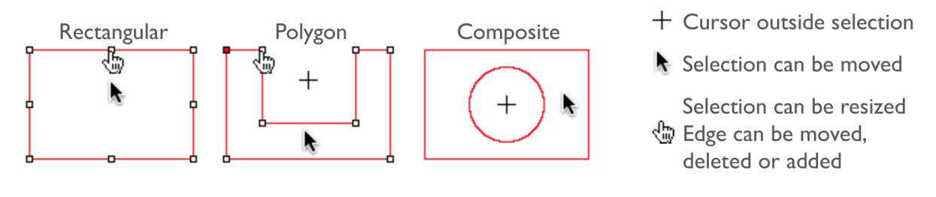
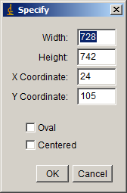
Editing selection
http://rsbweb.nih.gov/ij/docs/guide/146-27.html#toc-Subsection-27.12
Very useful: it puts your last ROI onto a new image

Slide 16
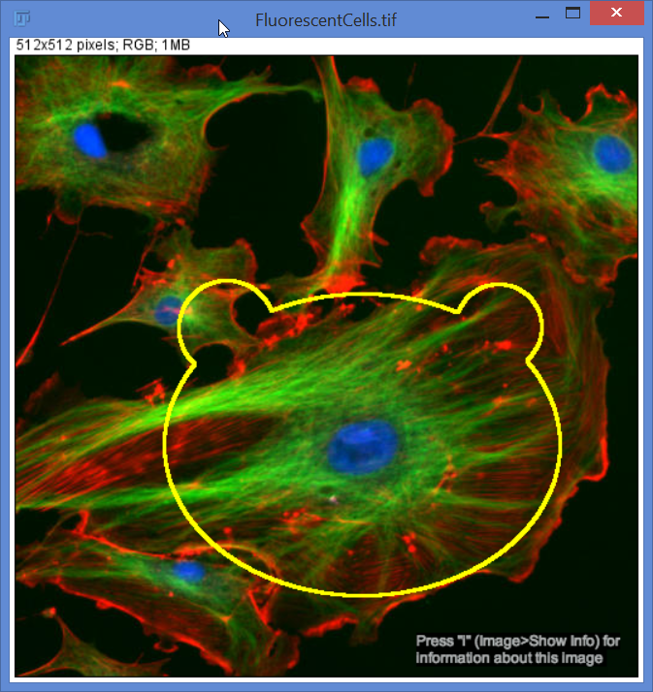
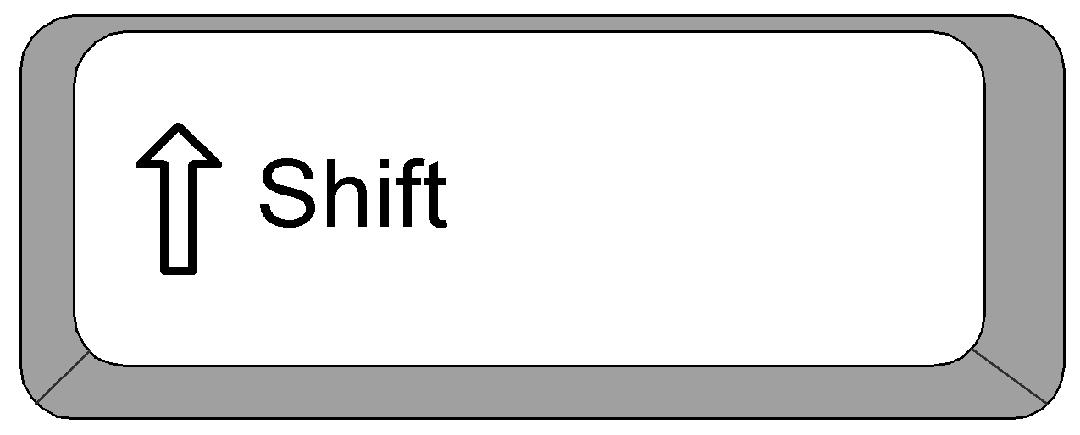
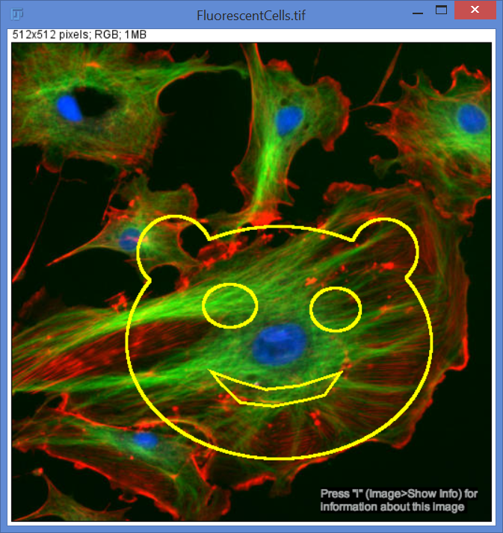
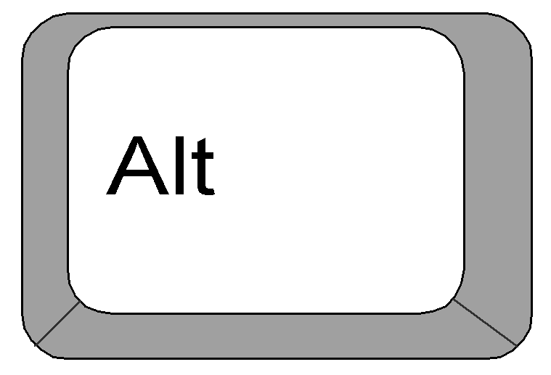
Composite selection http://rsbweb.nih.gov/ij/docs/guide/146-10.html#sub:Composite-selections
Exercise 6)
Draw a face!
File / Open Samples… FluorescentCells.tif
+
Add to selection
(release shift key to add non-square selection)
Selection tool
+
Remove from selection

Slide 17
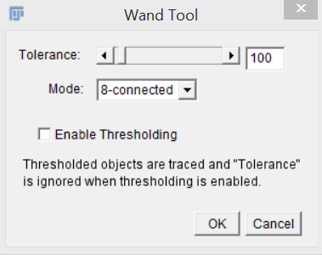
Magic wand http://rsbweb.nih.gov/ij/docs/guide/146-19.html#toc-Subsection-19.7
Selection range
=
initial value
+/- tolerance
https://imagej.nih.gov/ij/docs/tools.html
Watch this example: (we will do this together in a couple of slides)
Open Sample…
1) Hela Cells 5) Double click the Wand tool
2) Go to channel 3 (Blue) 6) 8-connected.
3) Select a nuclei with the wand… 7) Slide Tolerance…
4) Click in a nuclei

Slide 18
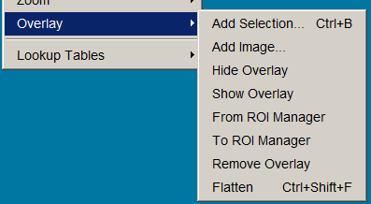
Overlay http://rsbweb.nih.gov/ij/docs/guide/146-11.html#sub:Overlay-Intro
ImageJ/Fiji can create and work with non-destructive overlays.
The overlay is preserved when an image is saved in TIFF format.
Image>Overlay
Overlay is very useful when using scale bars.

Slide 19
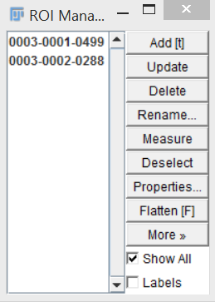
ROI Manager
Highlight one at a time
Rename
Measure (all sorts, covered later)
Properties… (colour, size, width)
Show all
Flatten (careful – Make a duplicate first)
More>> Save as… saves a zip file of all the ROIs
Add more ‘ROIs’…
Text tool, draw an area, write something, Press T
Arrow tool, press T

Slide 20
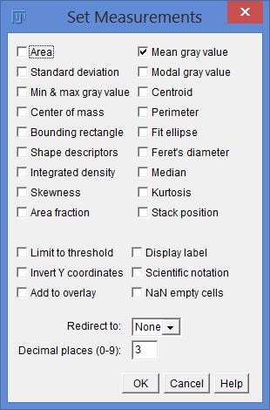
Measurements
Analyze / Set measurements…
Exercise 7) Measure stuff
Try it…
Open Samples / Hela cells
Use Magic Wand and ROI manager to select each nucleus.
Set a few measurements.
Measure those parameters.
You can save the results window as a excel, .csv or text file

Slide 21
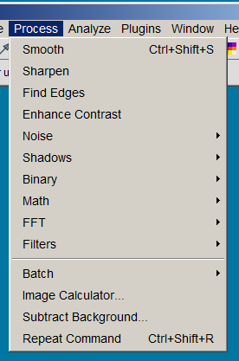
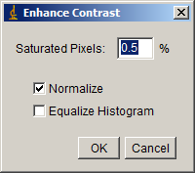
Process. Lots of functions, i.e…
Normalisation: linear stretch of the histogram, but changes the data!
Equalisation: non-linear stretch of the histogram (based on the square root of the intensity see http://homepages.inf.ed.ac.uk/rbf/HIPR2/histeq.htm#1)
Best setting: 0.35% Saturated pixels,
Don’t tick either Normalize or Equalize
Try it, (Images for users / RGB…/ Mito Hela Cells,
(H), (Shift C), Reset Brightness Contrast.
Then Enhance contrast.
Try Find Edges…

Slide 22
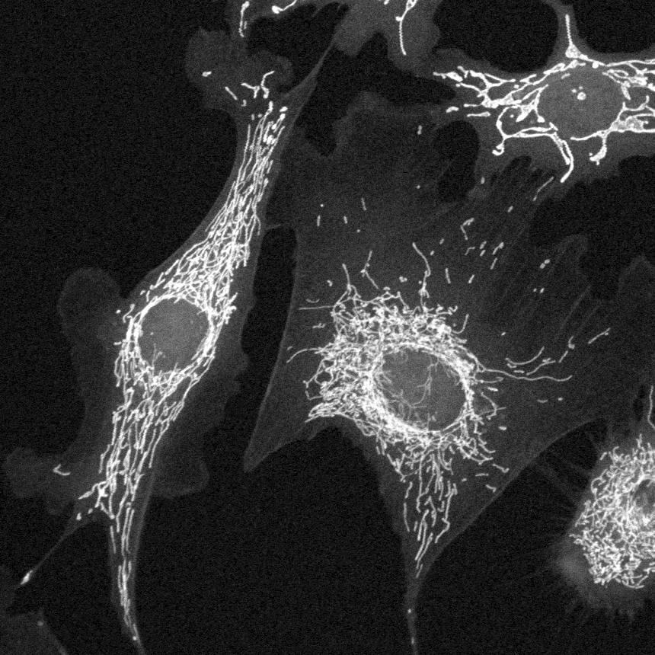
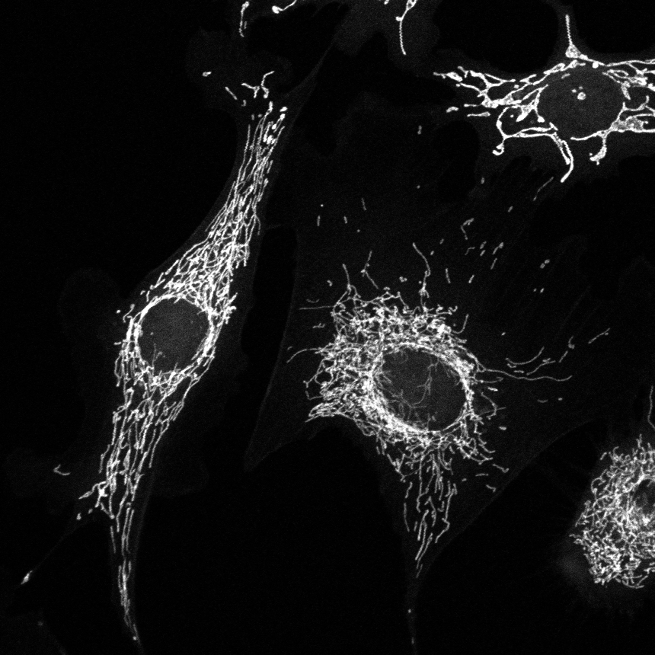
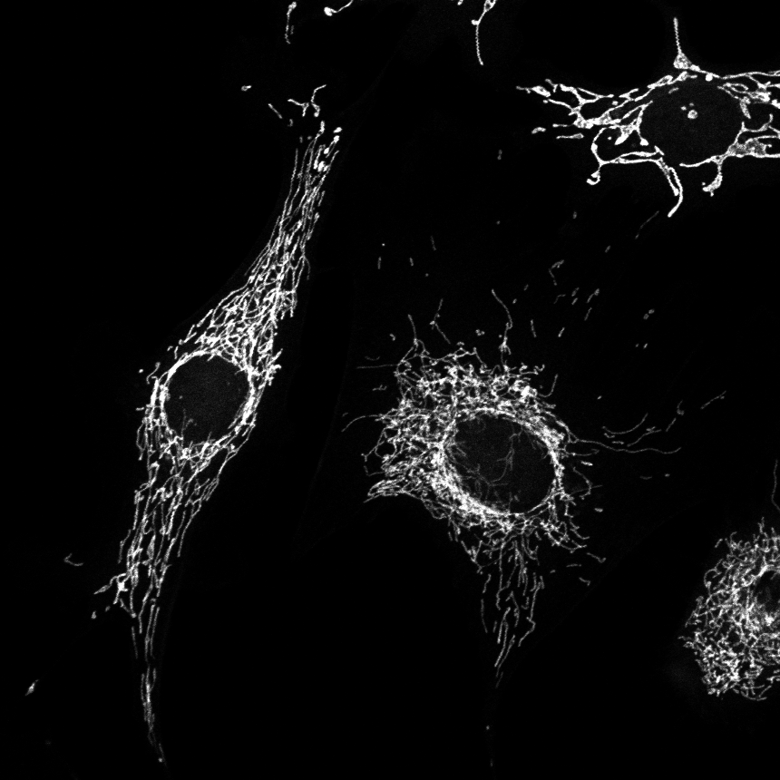
Process>Math>Gamma
Built-In function: http://rsbweb.nih.gov/ij/docs/guide/146-29.html#toc-Subsection-29.9
Macro: http://imagej.nih.gov/ij/macros/tools/GammaCorrectionTool.txt
Gamma
Faint objects can be made more intense without saturating bright objects (γ <1).
Medium-intensity objects can be made fainter without dimming the bright objects (γ > 1).
γ = 0.5
γ = 1
γ = 1.5
Non-linear, but OK as long as you say what you’ve done.
Do intensity analysis on un-manipulated image tho!
Can be very useful for segmentation.

Slide 23
Stacks
ImageJ/Fiji can display multiple spatially or temporally related images in a single window
The image set is called a stack and the images that make up a stack are called slices
In stacks, a pixel (which represents 2D image data in a bitmap image) becomes a voxel (volumetric pixel), i.e., an intensity value on a regular grid in a three dimensional space.
All the slices in a stack must be the same size and bit depth.
http://imagej.net/Z-functions

Slide 24
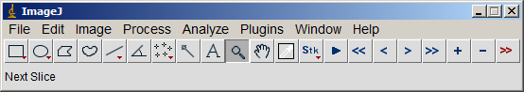
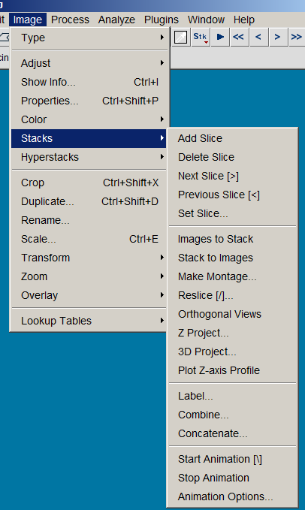
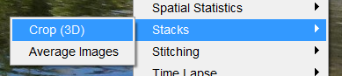
1
Stack Tools
Example:
Zebrafish
Z project
Extended Depth of Field
2
Image>Stacks>…
3
Plugins

Slide 25
Stack manipulation (1)
2
1
3
2
4
5
5
6
Sub-stack functions
6
1
stack
5
2
6
2
4
3
4
3
Stack reverser
4
2
5
3
1
1
6
images
5
Montage
Z-projection
1
2
3
4
5
6

Slide 26
Stack manipulation (2)
Interleave
De-interleave
concatenate
combine
6
Stack inserter

Slide 27
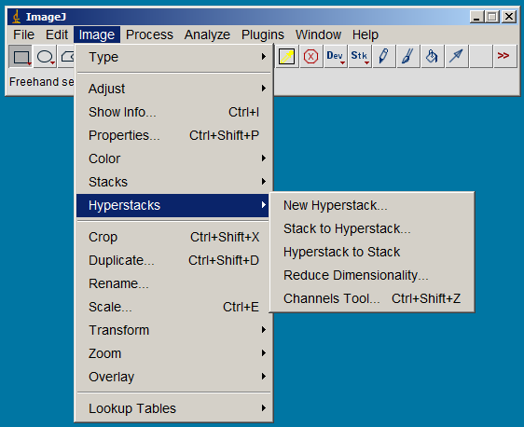
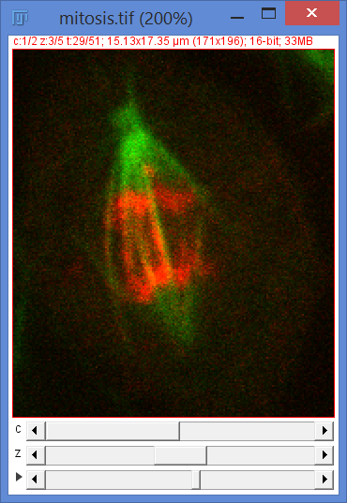
Image>Hyperstack
Hyperstacks are multidimensional images, extending image stacks to four (4D) or five (5D) dimensions: x (width), y (height), z (slices), c (channels or wavelengths) and t (time frames).
Open sample image ‘Mitosis
2 channels
5 z-slices
51 time-points

Slide 28
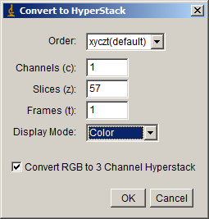
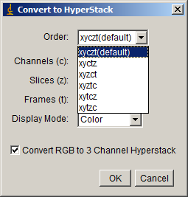
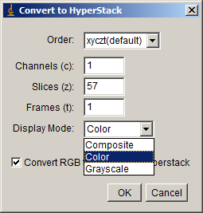
Stack to hyperstack …
Sometimes you get an image series that needs to be put together, for example from Volocity live imaging…
Example: Open samples…mitosis
Image / Hyperstacks / Hyperstack to stack…
Then reverse that with
Image / Hyperstacks / Stack to Hyperstack…
You need to know the stack order, and number in each dimension (xyzct)

Slide 29
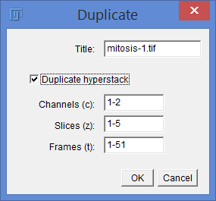
Reduce stack dimensions
Duplicate image (Ctrl+Shift+D)
Individual or all channels
Any range of z slices
Any range of timepoints

Slide 30
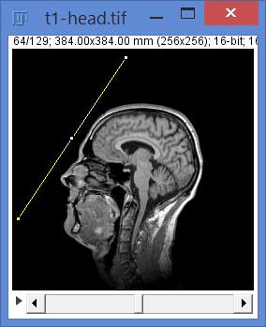
3D stacks: Examples
Open Samples > Confocal Series
Open Samples > Fly Brain
Open Samples > T1 Head
Try: Plugins / 3D viewer.
Try: Image / Stacks / reslice (shortcut = ‘/’)

Slide 31
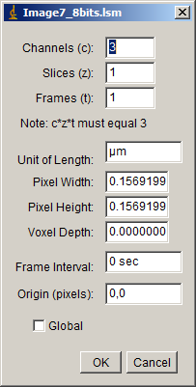
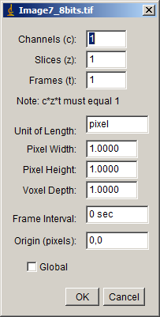
Image Properties (ctrl+shift+P)
Image>Properties …
Metadata
No Metadata
File : Fluorescent cell.lsm
File : FluorescentCells.tif

Slide 32




Scale Bar
Analyze / Tools / Scale bar… or Analyze / Set Scale

Slide 33


Image Stitching
Useful for histology (also can do 3D images)
Try it:
Plugins / Stitching / MosaicJ
Open Image Sequence
First image in 2D Stitching folder…
Click each image,
move it to roughly the right place
File / Create mosaic…

Slide 34


Image Stitching
Lazy way:
Plugins / Stitching / Grid Collection Stitching…
Choose the folder with your files, and wait…

Slide 35

Image Stitching
Lazy way:
Plugins / Stitching / Grid Collection Stitching…
Works for 3D too…
Use the 3D stitching folder…

Slide 36

Stack Registration
Useful when you have multiple serial sections
Files: ‘Rat Brain’, ‘H&E’ in Stack alignment folder
Plugins / Registration / StackReg (on the BIG-EPFL update site requires ImageScience also)
Translation : basic left right up down - Good basic alignment, little scope for error
Rigid body: rotation also (BEST) - Can make mistakes if segments have big differences.
Scaled rotation: scale also - Can make mistakes if segments have moderate differences.
Affine: most freedom to align - computationally tricky
Plugins /Registration / Linear Stack alignment with SIFT
Implements a patented algorithm assuming the images are all at the same scale.
Rigid is the best.

Slide 37

Where is that command?
Press ‘L’ = shortcut to Plugins / Utilities /Find commands
You can search for any command in Fiji...

Slide 38


Help / Update Fiji
Then Manage update sites…
http://fiji.sc/List_of_update_sites

